Slide 1

Cookie Clicker Automation Project
A UiPath RPA Process
Mentor: Andreea Diana Pop

Slide 2


Project Overview
The project automates the 'Cookie Clicker' game using UiPath workflows and activities for parallel browser interactions and event notifications about the progress (via email).
Key Tools Used:
- UiPath System, Mail, UI automation activities
- Modern workflow execution

Slide 3

Particularities and Key Challenges
Layered Architecture:
A structured design with dedicated workflows for each core activity and automation process.
Parallel Processing:
Simultaneous operations for improved efficiency, such as generating cookies while checking for potential upgrades in real time. (this one was a key challenge)
Upgrade Selection Strategy:
An optimization "algorithm" that selects the most suitable upgrades for the current game stage, ensuring maximum progress in minimal time. (also a key challenge)
Exception Handling:
Robust exception management to ensure a smooth user experience and maintain uninterrupted workflow execution.
Comprehensive Automation:
Automation covers both in-game actions and external notifications

Slide 4


Additional Aspects to Mention
We estimate that our application will achieve 2.5 times better progress than a human who continuously clicks and selects the best upgrades over an extensive period.
However, given that such consistency is nearly impossible for a human, our automation is projected to be approximately 4 times ahead in terms of game progression.

Slide 5

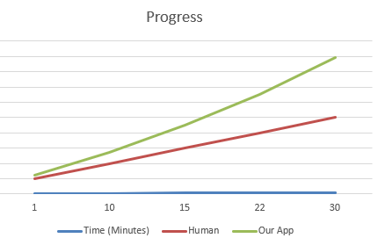
Additional Aspects to Mention
This chart illustrates the comparison between a user who continuously clicks and makes optimal upgrade choices and the progress achieved by our automation.

Slide 6
Conclusions
Summary:
Showcased the effectiveness of RPA in a real life scenario, repetitive tasks within a gamified environment.
Demonstrated the application's ability to make optimized decisions in real-time for upgrades, outperforming human players.
Ensured a robust and seamless process through comprehensive error handling and separated workflows.
Insights:
The automation achieves significant performance improvements, progressing faster than a human player due to consistent and efficient execution.
Our solution gives to the player the ability track its progress by the generated reports received by email

Slide 7



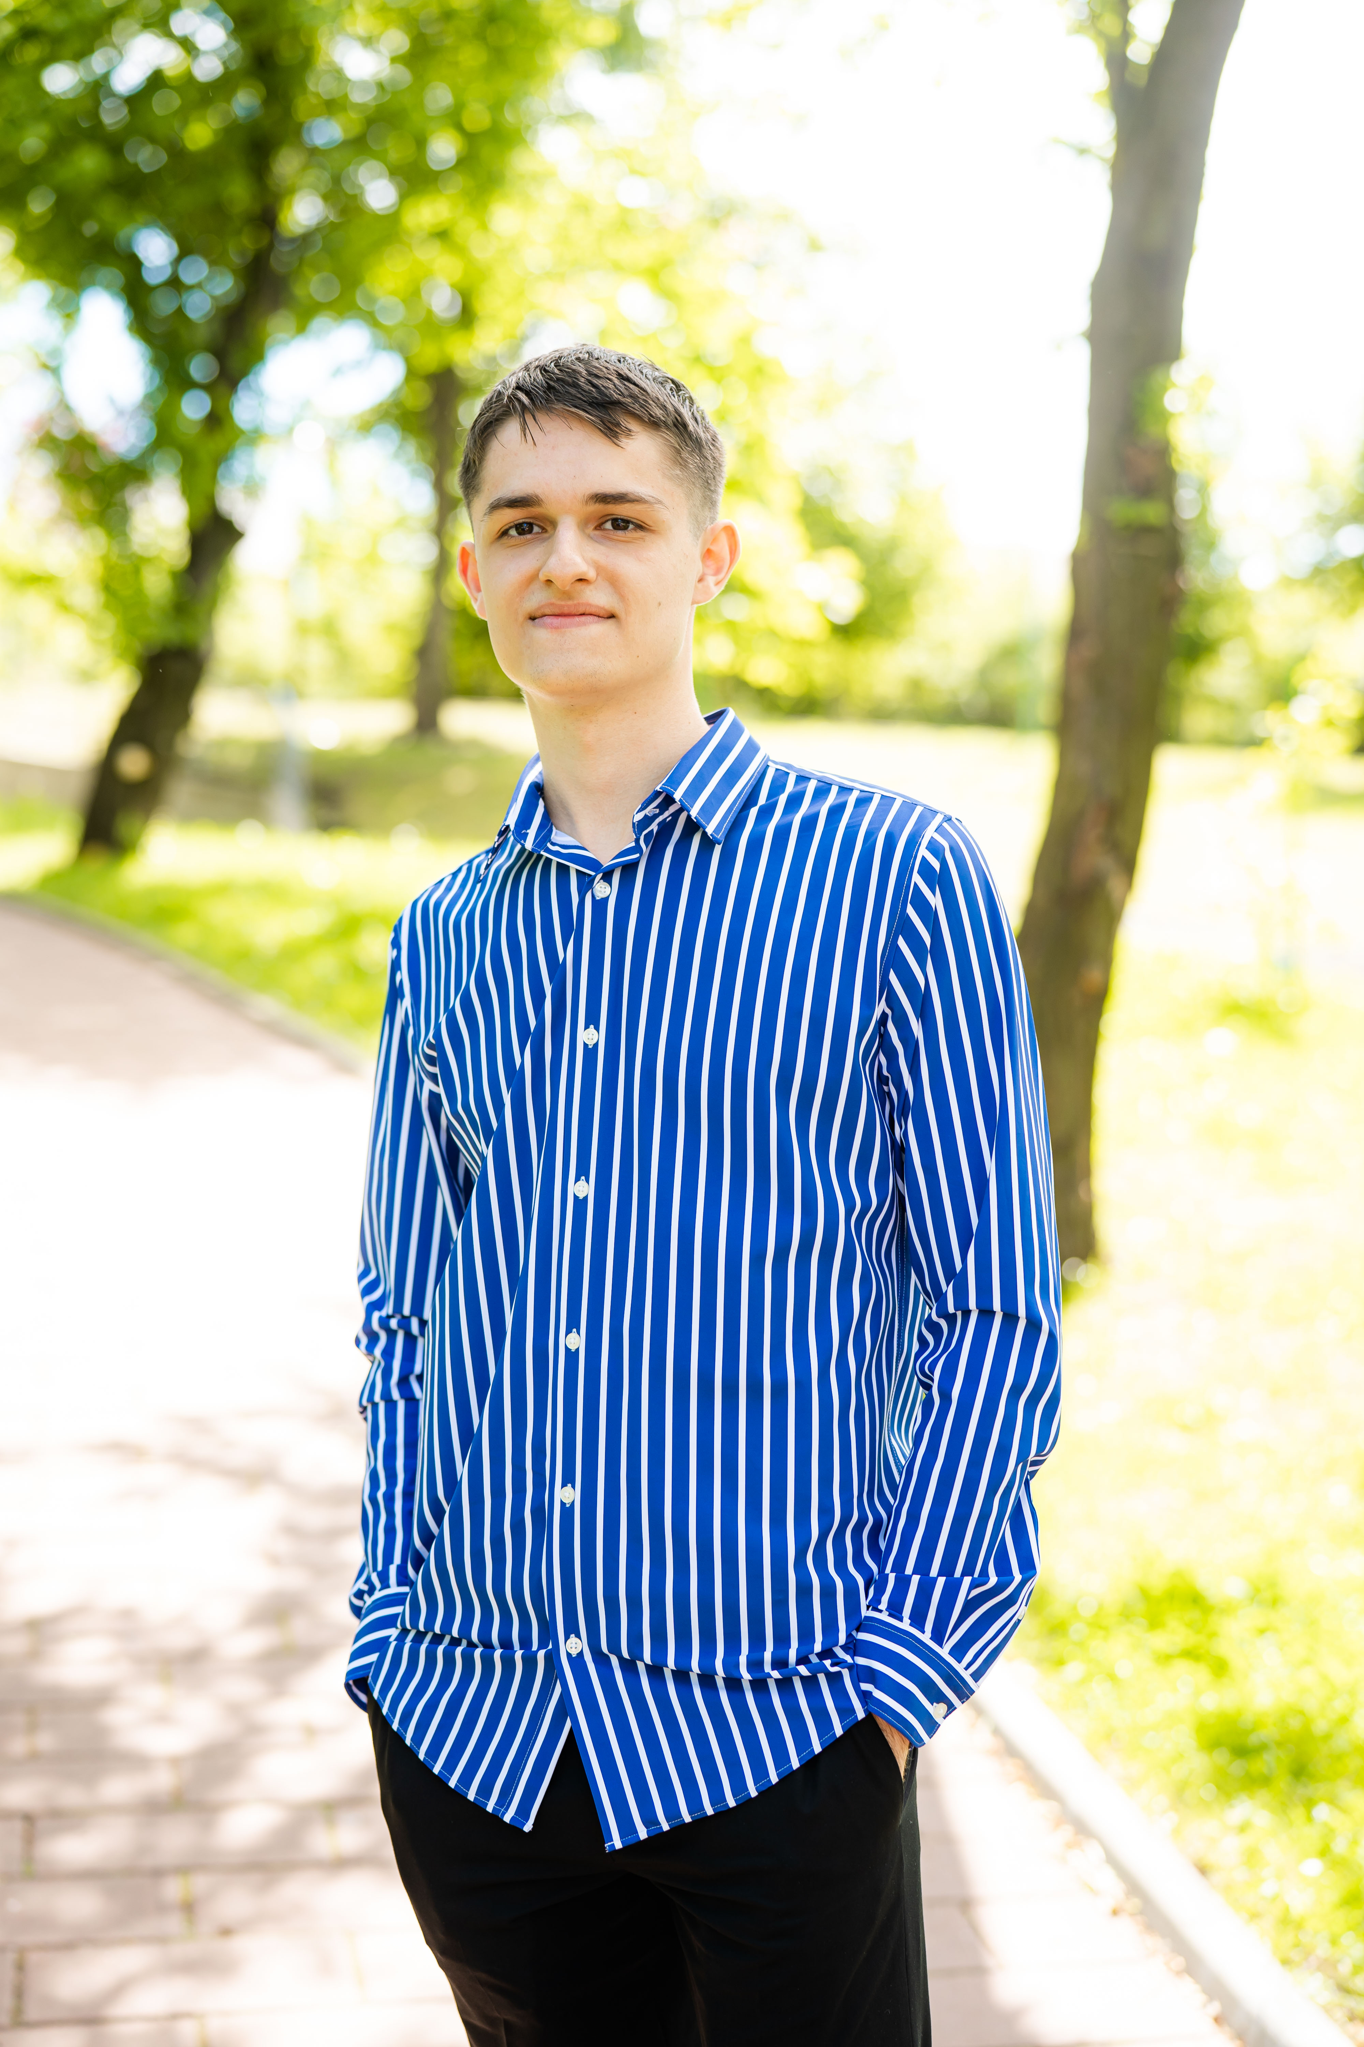

Kalman Andrei Horatiu
Manea Robert Petrisor
Ichim Andrei Vlad
Jorza Ionut Traian

